Slide 1
Flight Delays
L
How Long a Flight Will Delay at the Destination Airport?
Name: Vertulie Pierre Louis
Mentor: Shmuel Naaman

Slide 2




Ever happened to you ?
2
Delayed flight ?

Slide 3
Purpose, motivation and description:
The purpose of the project is to predict “How Long a Flight Will be Delay at the Destination Airport”?
In 2015 there were lots of flight delays in the United States. The U.S. Department of Transportation’s (DOT) Bureau of Transportation Statistics tracks the status of the flights by providing a summary of the arrival delays, departure delays, scheduled departure, on-time arrival in their monthly report.

Slide 4
Variable/Feature
My target variable is Arrival-Delay. It is a float
We also viewed all the other variables and did not do any feature selection because there were some variables that correlated with each other.
For example, Weather Delay, Departure Delay, Distance, and Carrier are important variables for our model.

Slide 5
Purpose, motivation and description:
For the prediction I used the basic models. I created a data set that can be used for both visualization and Model Building.
The purpose of visualization is to get a better inference of the data.
For the Split test, the dataset has been separated into training and Testing data so that prediction can be done on the testing data. I also import Tableau that can make the visualization more feasible.
The technical aspects used for visualization are Matplolib and seaborn. Including data manipulation: pandas, NumPy, modeling -sklearn: Linear Regression, Random Forest & Decision Tree.
.

Slide 6
Data acquisition
The data is acquired from Kaggle:https://www.kaggle.com/usdot/flight-delays.

Slide 7
Data Management
The data was in CSV file. It consists of three data sets: Flight Delays, Airlines and Airports.
The flight data set contains 5819079 rows with 31 columns and 14 different carriers.

Slide 8
Data Cleaning
We used isnull() to find the missing values in the dataset and dropped the rows which had missing values using dropna ().
We also converted categorical variables using one hot encoding but we did not use any other new variables.

Slide 9
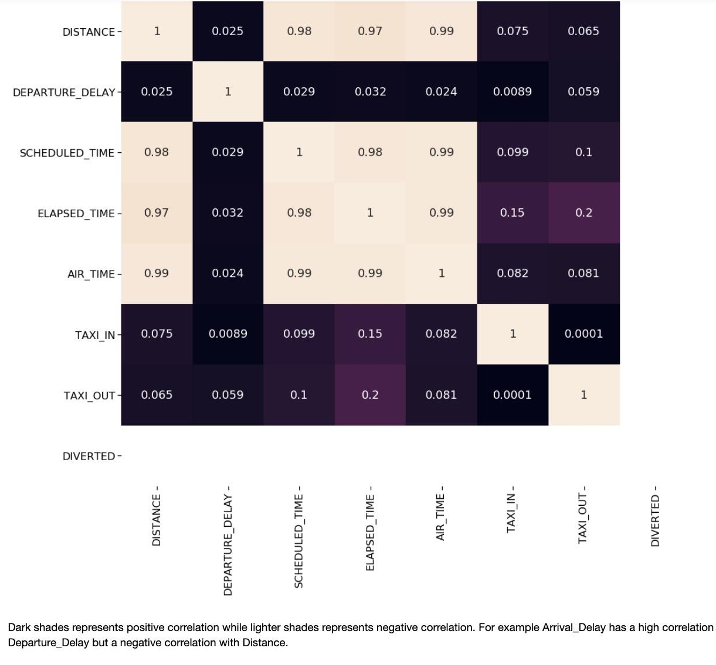
Exploratory Data Analysis
We look at all the variables and we performed the correlation analysis to identify the important variables.
This heat map shows a visual color summary of the data information. As you can see the scheduled time is highly correlated/dependent with distance, elapsed time and air time.
It is obvious that the longer the distance, the higher the airtime. The dark cells shows less dependency between features.

Slide 10
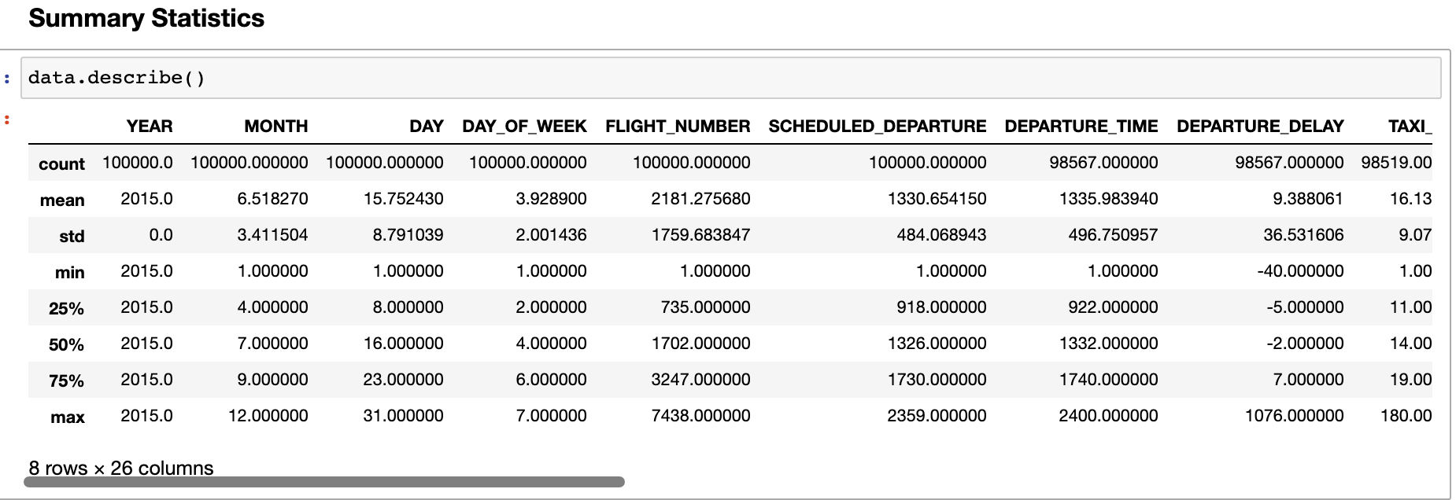
Exploratory Data Analysis
We also used the described () to get a statistical summary of the data. It displays the count, mean, std, min, max.
The Summary helps me understand the data elements and its abnormality better.

Slide 11
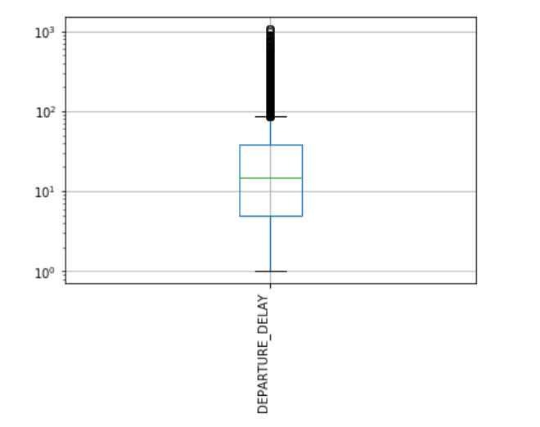
Exploratory Data Analysis
Just like the missing values, the data might also contain some outliers. To find them, I checked the distribution of a single variable Departure-Delay using a boxplot.

Slide 12
Data Transformation
We converted the categorical variables to dummy variables (one hot encoding). Then we scaled the data using the standard scaling method.

Slide 13
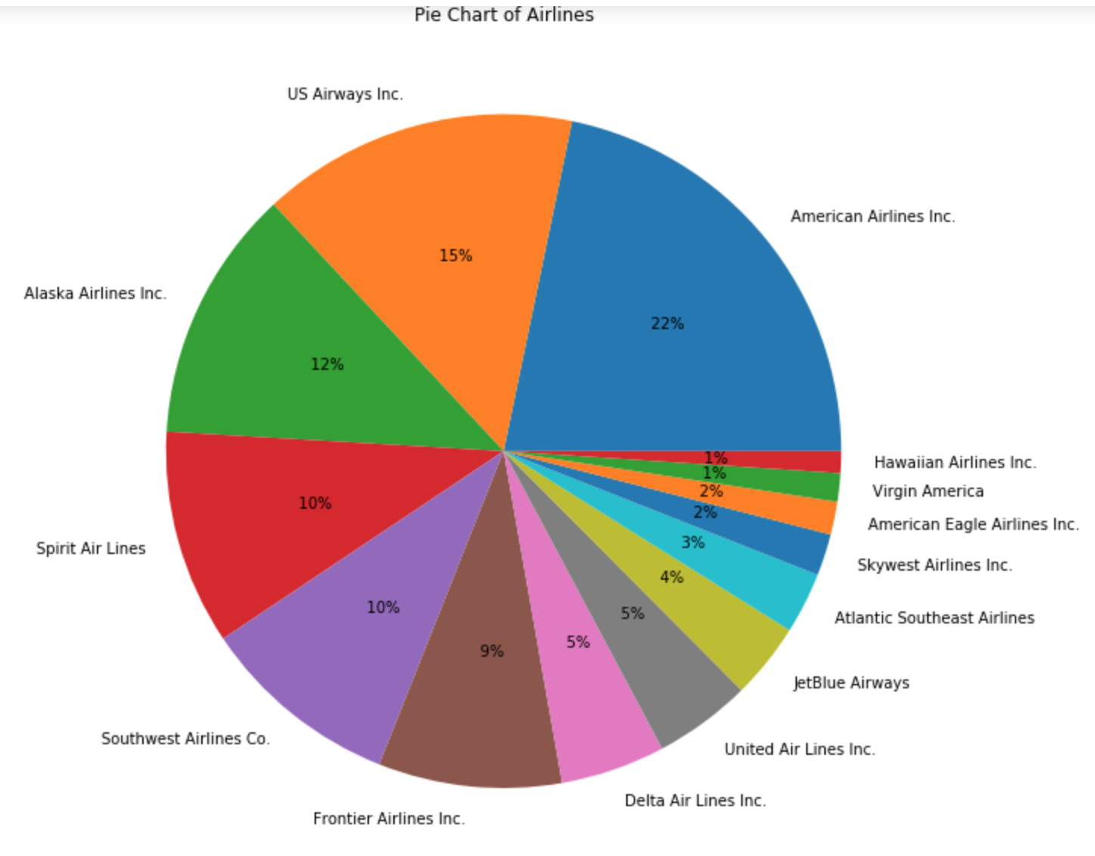
Visualizations
I created a pie chart to display the percentage of each Airline in the database.
American Airlines 22%
Hawaiin and Virgin America have 1%

Slide 14
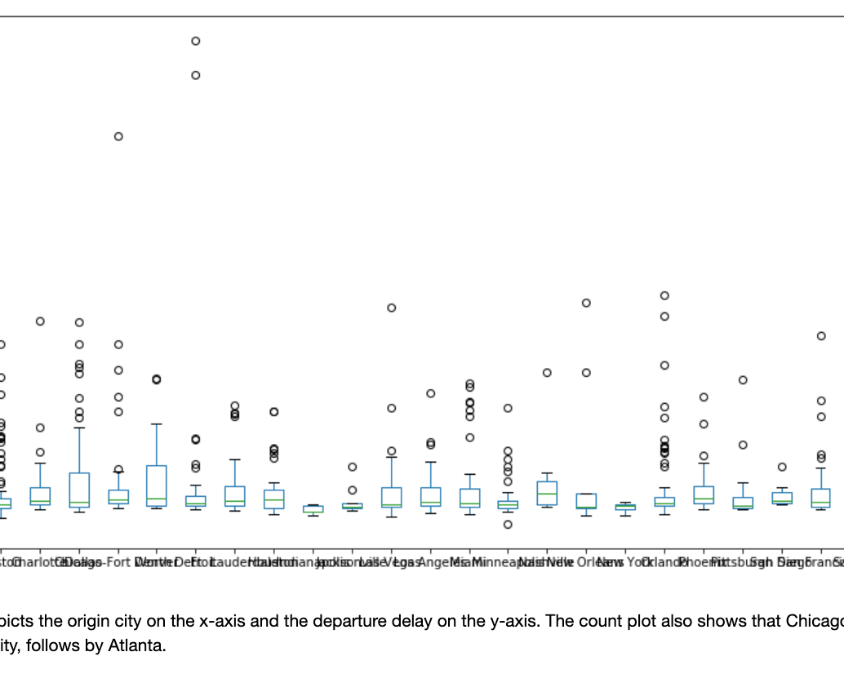
Visualization
This pivot table show a standardized way of displaying the distribution of data.
It also summary the outliers in the data.
.

Slide 15
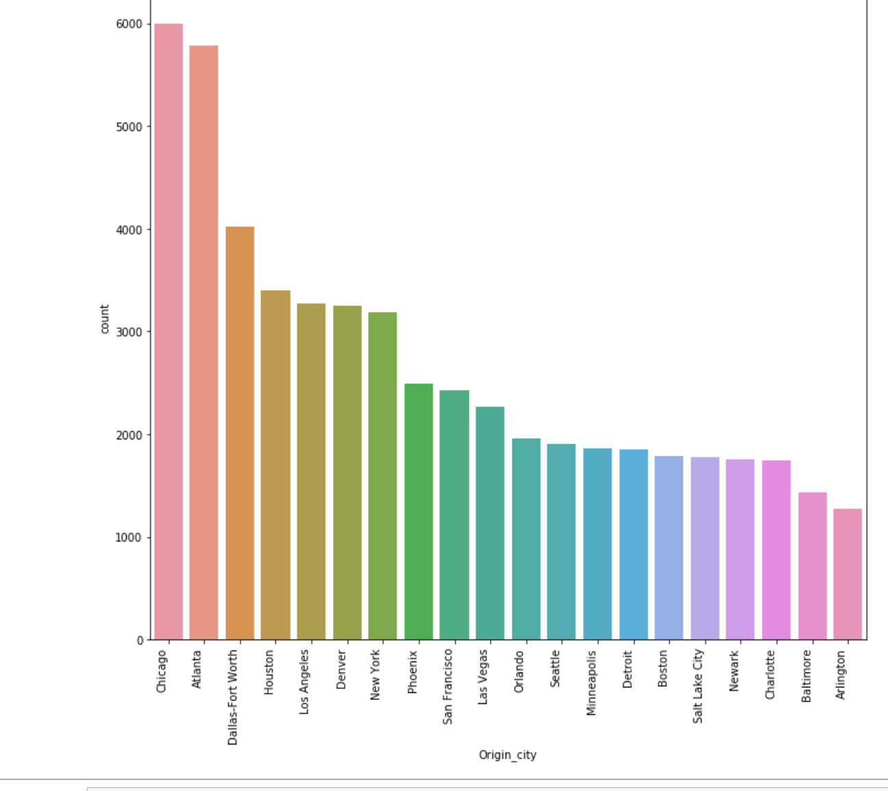
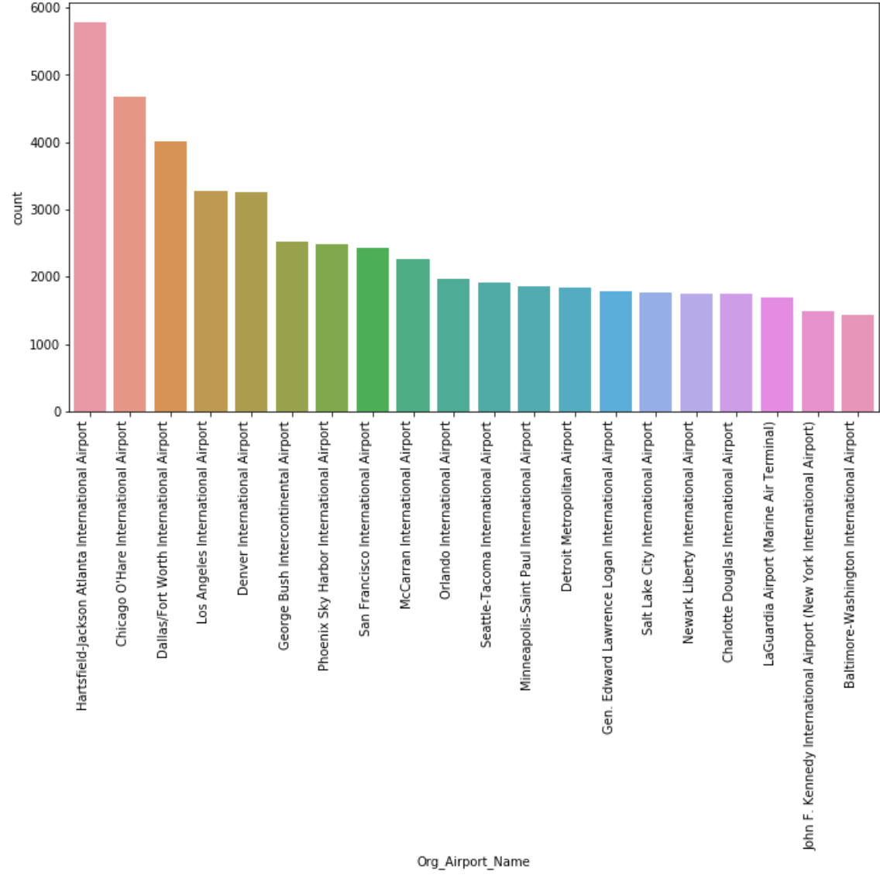
Data Visualization
10
This Count plot shows flights delayed
by Origin_City
This plot shows flights delayed by Origin_Airport_name
t
It is seen that more delays are observed from Hartsfield–Jackson Atlanta International Airport. And less delay from Baltimore washington international airport
Chicago has the most delays by Origin_City. Arlington has the least delays.
Notes:
These two plot shows the delay counts by city and airport. It shows that Chicago city has the most delayed flights and Hartsfield–Jackson Atlanta International Airport is tha aiport that had most flights delayed.

Slide 16
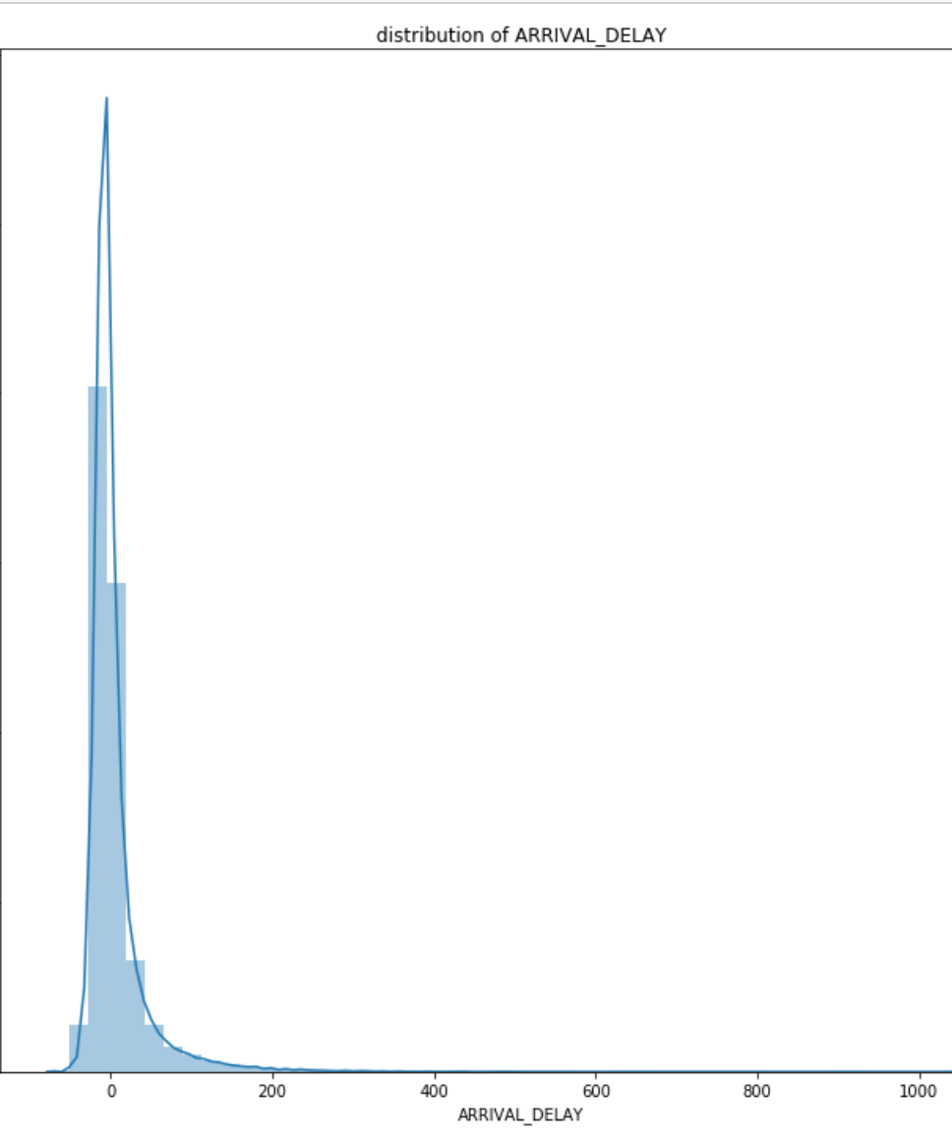
Visualization
Distribution Plot
The graph shows the density and histogram of Arrival_Delays. The dependent variable is right skewed/positively skewed. It means that it has a lot of positive delays instead of negative delays/no delays.

Slide 17
Feature Selection:
We dropped some unnecessary columns from the dataset after the Pearson correlation analysis. These columns are Org_Airport_Name, Origin_Cit, Dest_Airport_Name, Destination_City.
They did not have any effect on the output.

Slide 18
Modeling:
To make the prediction I tried “the basic model types” Linear Regression, decision Tree and Random Forest Regression.
Linear Regression is a machine learning algorithm based on supervised learning.
Y = a + bX
It was appropriate to use linear regression because it performed better on the test set in contrast to the other models who tend to be overfitted on the training dataset.
It was not appropriate to use linear regression because it tends to perform better when there is linear relationship between input and output.

Slide 19
Advantages/Disadvantages
Linear regression provides a powerful statistical method to find the relationship between variables. However, it’s only limited to linear relationships.
Linear regression produces the best predictive accuracy for linear relationship whereas its little sensitive to outliers and only looks at the mean of the dependent variable.

Slide 20
Decision Tree Vs Random Forest
We tried decision trees to look for the hidden patterns in the data.
We used Random Forest to see if ensemble of decision trees performed any better than the Decision Trees

Slide 21
Random Forest
Advantages
The random forest algorithm works well when the data sets have both categorical and numerical features.
The random forest algorithm also works well when data has missing values or it has not been scaled
Disadvantages
A major disadvantage of random forests lies in their complexity. Random Forest required much more computational resources, owing to the large number of decision trees joined together. Due to their complexity, they require much more time to train than other comparable algorithms.

Slide 22
Advantages/Disadvantages/Decision Tree
Decision tree can handle both numerical and categorical data. And it is extremely fast to run.
Disadvantage
The model is prone to overfitting, especially when a tree is particularly deep.

Slide 23
How Do We Picked Parameters For The Model Used?
For linear regression, we used the default parameters of sklearn
For decision tree, we used mse as the error, all of the features for max_features, and we did not limit the max_depth.
For random forest, we searched for number of trees and max_depth using GRID search.
Example, number of trees that were searched was [1,4,7,11] and max depth [1,5,10,15]

Slide 24
Evaluating The Model:
We used gridsearch to cross validate the model. We also used Root Mean Squared Error(rmse) and R-squared.
To evaluate the performance of the model.

Slide 25
Communication
Out of these 3 models, linear regression performs better.
Linear Regression
Mean Absolute Error: 18.39922563412102
Mean Squared Error: 1277.0927484702281
Root Mean Squared Error: 35.73643446778411
R2 : 0.028298113427712046
Random forest Regressor
Mean Absolute Error: 17.29092119928667
Mean Squared Error: 1425.9005813698175
Root Mean Squared Error: 37.761098783931295
R2 : -0.08492534049798817
DecisionTreeRegressor
Mean Absolute Error: 21.48367142220241
Mean Squared Error: 2389.095575122604
Root Mean Squared Error: 48.878375332273514
R2 : -0.8177917620540451

Slide 26
Communication/ Findings
We can improve the performance by trying polynomial regression or some complicated model like neural network.

Slide 27
Conclusion
We used three different algorithms to Predict Flight Delays at the destination Airport. However, Linear regression performs better than the other models. For future reference, We can improve the performance by trying polynomial regression or some complicated model like a neural network.

